Slide 1

Engaging Young Men in Pregnancy Prevention
Child Trends & Promundo
Healthy Teen Network 2017 National Conference
Social Norms & Culture: Honoring Experiences & Perspectives
October 4, 2017
Jenita Parekh, Ph.D., Jane Kato-Wallace, MPH, Jennifer Manlove, Ph.D., Makedah Johnson, BS
This presentation was made possible by RFA-DP-15-007 through a partnership between the Teen Pregnancy Prevention Program at the Office of Adolescent Health, U.S. Department of Health and Human Services, and the Centers for Disease Control and Prevention, Division of Reproductive Health. Contents are solely the responsibility of the authors and do not necessarily represent the official views of the Office of Adolescent Health or CDC.

Slide 2
Introductions
Name
Experience or role working with young men and unintended pregnancy prevention
Notes:
Here Promundo and CT staff introduce ourselves
Show of hands- how many are working with young men?

Slide 3

Objectives
The objectives of this session are to…
  Better understand and discuss strategies related to:
    pregnancy intentions & practices that lead to early and unplanned pregnancy
    contraceptive knowledge and communication among couples
    gender norms and their relationship to early pregnancy
  Discuss formative and pilot findings from a gender transformative program to prevent teen pregnancy and discuss strategies for engagement of young men
Notes:
Early pregnancy is defined as a young man fathering a pregnancy before the age of 25. Among men ages 20-24, 7% of pregnancies fathered were unwanted and 41% of pregnancies fathered were mistimed--vs. 6% unwanted and 29% mistimed among men ages 25-29. (Martinez et al., 2006)

Slide 4
Pregnancy Intentions among Young Men

Slide 5

Pregnancy Intentions among Young Men
VS.
81% of unmarried men aged 15-19 report that the pregnancy was unintended.
43% of Hispanic men and 44% of black men will father a birth by age 25.
22% of white men will father a birth by age 25.
65% of men aged 20-24 report that the pregnancy was unintended.
(Martinez et al., 2012)
(Manlove et al., 2014)
Notes:
Most unmarried fathers under the age of 25 report that the pregnancy was unintended.
Minority men are more likely to father a birth by age 25 than their white counterparts

Slide 6
Pregnancy Intentions among Young Fathers
Accidental
Just not thinking
Unplanned but not expected
Planned
  Source: Augustine et al., 2009
Notes:
These categories represent a continuum of intentionality
and emerged from inductive analysis of the fertility accounts of 171 men reporting
on 424 pregnancies, including those that were miscarried and terminated.2
They reflect the language that the men used to describe their intentions prior to
conception and capture some of the complexity of the fertility process. We show
that the majority of these pregnancies were neither planned nor accidental but
somewhere in between (the intermediate categories of just not thinking and
unplanned but not unexpected),
Accidental- father believed he was infertile or birth control was being used (17%)
Just not thinking- where the father knowingly engaged in unprotected
sex but claimed he did not think much about the consequences), (50%) Men in most difficult financial situations and least stable relationships were in the just not thinking category.
Unplanned but not expected- where the father knowingly engaged in unprotected sex and
claimed he considered the consequences and was agreeable to the possibility of
Pregnancy
Planned- couple agrees and takes steps to do so. (15%)
This ambivalent attitude towards pregnancy was also found among teens and young mothers. (Bruckner et al., 2004; Baldwin, 2013).
Young fathers- below the poverty line.

Slide 7
Pregnancy Intentions among Young Fathers
Half of pregnancies occur when fathers report they are simply “not thinking” of consequences
  Did not have a desire to get pregnant
  Knowingly engaged in unprotected sex and other risk behaviors (e.g. sex with multiple partners)
  Majority of these men felt happy or excited when found out their partner was pregnant
  Source: Augustine et al., 2009
Notes:
Did not think of consequences
Author interpretation of data:
Fathers had no desire for pregnancy and embrace fatherhood when it comes
Fatherhood is at least ambivalently desired
**POTENTIAL CUT**
Interviews with low-income fathers to assess their motivation for having children, despite their low intentions and/or socioeconomic disadvantage found that⁹…
Some men contributed their child’s conception to “just not thinking,” or not placing importance on preventing pregnancy—these men reported engaging in other risk-behaviors during the time of their child’s conceptions (e.g. delinquency, sex with multiple partners)
Other men who considered themselves to be in better economic situations and had more relationship stability when their child was conceived, were open to fatherhood—but not actively planning to get their partner pregnant
The findings suggest that the majority of fathers did not have strong intentions to get their partner pregnant; yet, they left the risk for pregnancy to “chance.” Researchers propose that despite the economic disadvantage of these fathers, some men may view fatherhood as desired source for meaning and identity

Slide 8
Discussion
Based on your experience working with young men, what do you think contributes to this disconnect between intentions and behaviors?
How might you address closing the gap between intentions and behaviors with teens and young adults you've worked with?
Notes:
There is a disconnect when only 15% of births are planned.
What do you think contributes to this disconnect?
There might be the larger question of should we close the gap between intentions and behaviors?
Talk to people at table (3 tables take first and 3 tables take second). 5 minutes to discuss, 5 report back.

Slide 9
Contraceptive Knowledge and Communication

Slide 10
Contraceptive Knowledge and Communication
Young men (15-19) who did not receive formal sex education have lower levels of condom use and consistency. (Manlove et al., 2008)
Young men have low levels of condom use consistency. (Copen, 2017)
53.5% of teens (15-19) consistently use condoms.
29.5% of young adults (20-24) consistently use condoms.

Slide 11

Contraceptive Knowledge and Communication
In more than 1 in 5 young adult couples (18-26), men inaccurately reported their partner’s method use. (Karberg et al, 2016)
35% of young adult men (18-29) reported that they did not know about IUDs and 63% reported that they did not know about implants. (Kaye et al., 2009)
Notes:
Young minority men report especially low rates of contraceptive knowledge, especially for LARCs. (Marshall & Gomez, 2015; Frost et al., 2012; Borrero et al., 2013)

Slide 12
Contraceptive Knowledge and Communication
There may be gaps in couples’ communication surrounding birth control. (Karberg et al., 2017)
Young men’s lack of knowledge may affect their willingness to communicate with their partners.

Slide 13
Contraceptive Knowledge and Communication
Additional findings from formative activities to inform our intervention also demonstrate a lack of knowledge about contraception among young men:
  “I’ve never heard of the IUD or the implant.”
  “I don’t believe the idea that girls can take pills or injections to prevent getting pregnant. It sounds like a fantasy, like that’s not real.”
Notes:
Conducted other research that found if they have a male partner that is anti hormonal method, that that can affect their method choice, so the male partner can influence partner’s choice of an effective method.

Slide 14
Contraceptive Knowledge and Communication continued
  “I don’t think they [other young men] would talk about either of those, but they would be more likely to talk about STDs. They [young men] would think getting those viruses would be worse than getting someone pregnant.”
Notes:
Jenita

Slide 15
Discussion
What does it take to increase communication with partners around contraceptive use?
What does it take to improve condom use consistency and birth control use consistency in relationships?
Notes:
Recap of findings: gaps in couple’s communication surrounding birth control, low levels of contraceptive knowledge (esp. of LARC methods) among young men, young males tend to prioritize STI prevention over pregnancy prevention, which may lower their levels of consistency when using condoms and other methods of contraception

Slide 16
Gender Norms

Slide 17
Activity

Slide 18


Pop Quiz!
You will see 3 signs:
    10% - 30%
    31% - 55%
    56% - 75%
I will read a series of statements with results from the Man Box study in the U.S.
Stand by the sign that best represents the % of men who you believe “Agreed” + “Strongly Agreed” with the statement.
Source: Heilman, B., Barker, G., and Harrison, A.(2017). The Man Box: A Study on Being a Young Man in the US, UK, and Mexico. Washington, D.C. and London: Promundo-US and Unilever
Notes:
Carried out in U.S., Mexico and the UK this research was carried out using an email and telephone survey where we gathered a representative, random sample of young men aged 18-30 representing social and ethnic diversity in each country. Also included FGs with young men to hear what it means to be a man. Sample in each country was 1,328 in U.S.. Datasets have been weighted to representative census proportions in 3 categories: age, ethnicity, income.

Slide 19
First Statement
Society as a whole tells me that…
A “real man” should have as many sexual partners as he can
What % of men in the U.S. agreed or strongly agreed with this?
60%
Compared with 51% in the UK and 42% in Mexico
Notes:
Carried out in U.S., Mexico and the UK this research was carried out using an email and telephone survey where we gathered a representative, random sample of young men aged 18-30 representing social and ethnic diversity in each country. Also included FGs with young men to hear what it means to be a man.
The Man Box refers to a set of socially reinforced rules about what “real men” should do

Slide 20
Second Statement
Society as a whole tells me that…
Guys should act strong even if they feel scared or nervous inside
What % of men in the U.S. agreed or strongly agreed with this?
75%
Compared with 64% in the UK and 59% in Mexico
Notes:
Carried out in U.S., Mexico and the UK this research was carried out using an email and telephone survey where we gathered a representative, random sample of young men aged 18-30 representing social and ethnic diversity in each country. Also included FGs with young men to hear what it means to be a man.
The Man Box refers to a set of socially reinforced rules about what “real men” should do

Slide 21
Third Statement
In my opinion….
If a guy has a girlfriend or wife, he deserves to know where is all the time.
What % of men in the U.S. agreed or strongly agreed with this?
46%
Compared with 37% in the UK and 26% in Mexico
Notes:
Carried out in U.S., Mexico and the UK this research was carried out using an email and telephone survey where we gathered a representative, random sample of young men aged 18-30 representing social and ethnic diversity in each country. Also included FGs with young men to hear what it means to be a man.
The Man Box refers to a set of socially reinforced rules about what “real men” should do

Slide 22
The Man Box Study
What does it mean to be a young man?
To what extent do young men internalize and agree with these rigid norms about what “real men” believe and how they should behave?
Do these expectations matter for young men’s lives, or for the lives of those around them?
Notes:
What do gender norms have to do with young men and pregnancy prevention?
Carried out in U.S., Mexico and the UK this research was carried out using an email and telephone survey where we gathered a representative, random sample of young men aged 18-30 representing social and ethnic diversity in each country. Also included FGs with young men to hear what it means to be a man.
The Man Box refers to a set of socially reinforced rules about what “real men” should do

Slide 23
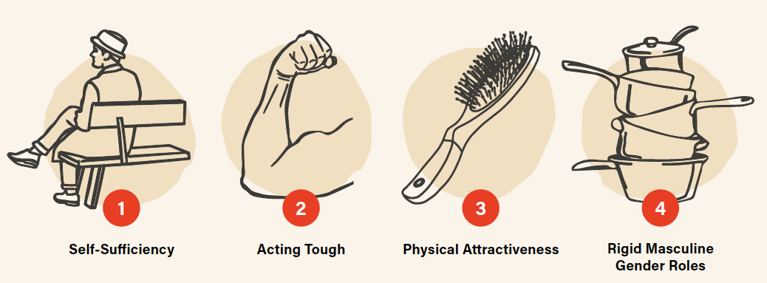
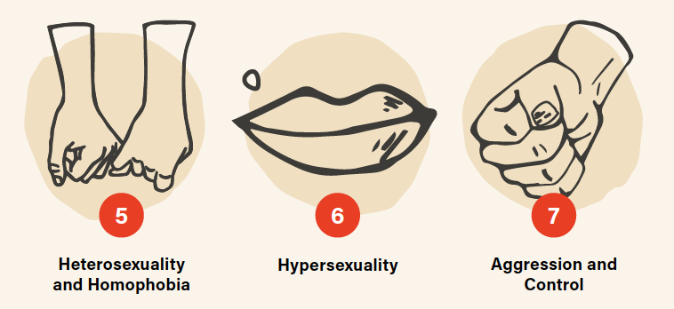
The Man Box Scale
7
“Pillars”
17
Messages
Notes:
So what does the constructed tool look like:
- Self-sufficiency: Men should figure out their own personal problems on their own w/o asking others for help
- Acting tough: Guys should act strong even if they feel scared or nervous inside; guy who doesn’t fight back is weak
- Physical attractiveness: It is very hard for a man to be successful if he doesn’t look good; hard for a man to be successful if he doesn’t look good
- Rigid Masculine Gender roles: Not good for a boy to learn how to cook, sew, take care of children, husband shouldn’t have to do household chores, men should be the ones to bring money home
- Heterosexuality and homophobia: A gay guy is not a real man, straight guys being friends with gay guys is totally fine and normal (positive statement)
- Hypersexuality: A real man should have as many partners as he can; A real man would never say no to sex
- Aggression and control: Men should use violence to get respect, men should have final decisions, if a guy has a GF or wife he deserves to know where she is all the time

Slide 24
Implications for Pregnancy Prevention
  Boys’ and young men’s greater decision-making power within relationships make it difficult for women to negotiate male condom use, access sexual and reproductive health services, and negotiate sex in general. (Blanc, 2001; Rottach et al., 2009)
  There are real costs to women and girls when men and boys are not engaged in efforts to challenge harmful gender norms

Slide 25
Discussion
How have you seen gender play a role in condom negotiation and early pregnancy in your work?

Slide 26
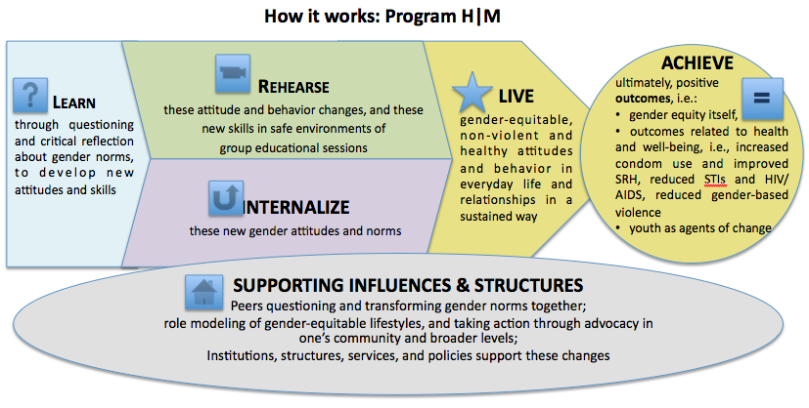
Program H|M|D Model
Notes:
Our on-the-ground work
Theory of change
Challenging norms, assumptions, expectations and stereotypes
Promote transformation, adoption of new models, breaking out of boxes
Inter-generational dialogue
Highlighting health benefits
Engaging peers in community change

Slide 27
A Look at the Results
Pillar 1: Self-Sufficiency
% who agree or strongly agree that “In my opinion…”
 | U.S. | U.K. | Mexico
A man who talks a lot about his worries, fears, and problems shouldn’t get respect. | 30% | 31% | 18%
Men should figure out their personal problems on their own without asking others for help. | 40% | 36% | 35%
Notes:
Elaborate on why we’re comparing country results

Slide 28
A Look at the Results
Pillar 7: Aggression and Control
% who agree or strongly agree that “In my opinion…”
 | U.S. | U.K. | Mexico
Men should use violence to get respect, if necessary. | 23% | 25% | 10%
A man should always have the final say about decisions in his relationship or marriage. | 34% | 33% | 21%
If a guy has a girlfriend or wife, he deserves to know where she is all the time. | 46% | 37% | 27%

Slide 29
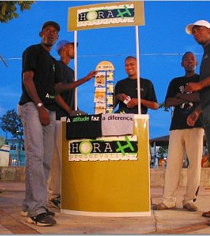
In multiple evaluation reviews, which programs to engage men and boys show impact?
Those that made questioning what it means to be men central to their intervention
Those that have a longer duration (10-16 sessions, campaigns that last 6-9 months)
Those that have multiple components
Those that engage men as part of the solution and in the design of messages

Slide 30
Current Strides

Slide 31
Current Strides
CDC & OAH funded evaluations of teen pregnancy prevention programs designed specifically for young men
  Manhood 2.0 in DC - Adaptation of Program H specifically for U.S. context
  Columbia University- evaluating computer-assisted motivation interviewing in Bronx and Manhattan
  NYU - evaluating “Fathers Raising Responsible Men” in South Bronx
Notes:
Columbia University: evaluating computer-assisted motivational interviewing (CAMI) intervention in the Bronx & Upper Manhattan
NYU: evaluating an teen pregnancy prevention program, “Fathers Raising Responsible Men” in South Bronx
Promundo: evaluating an innovative teen pregnancy prevention curriculum, Manhood 2.0 in DC

Slide 32

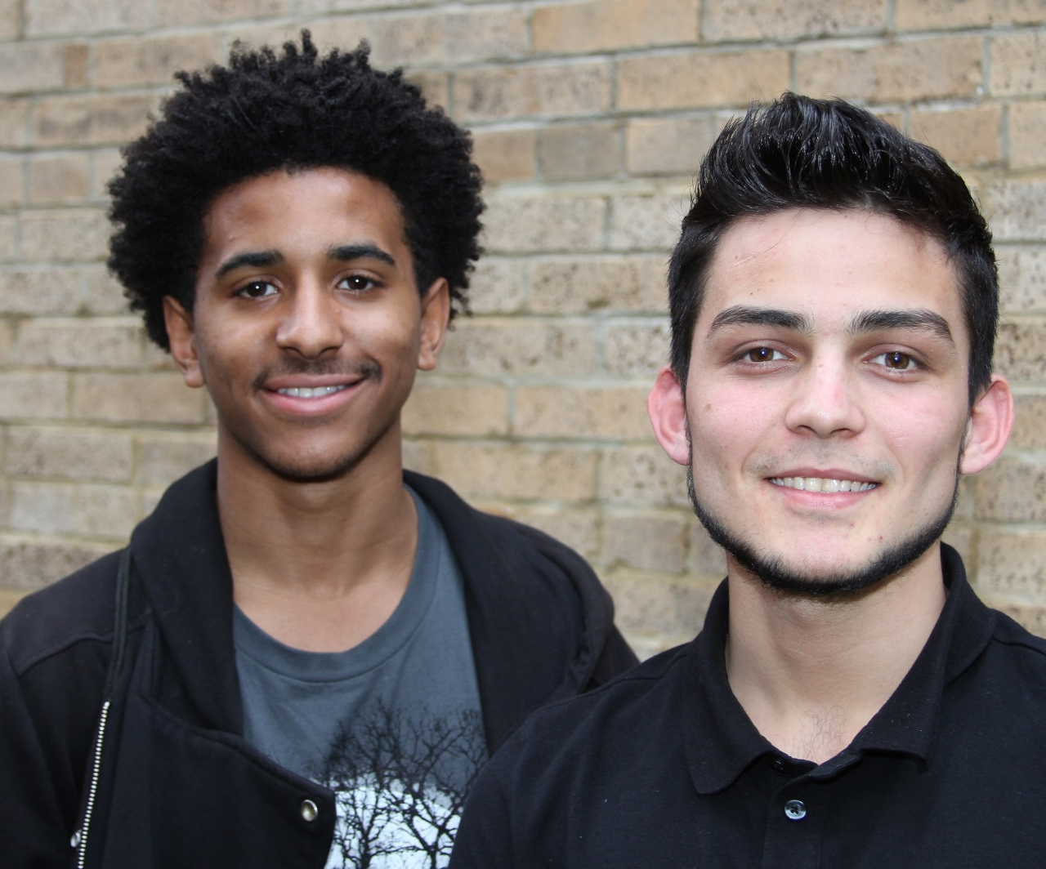

Manhood 2.0 Study
Pregnancy prevention curriculum designed for young men aged 16-22
  Teaches young men about healthy masculinity, relationships, and sexual decision-making
  Randomized Controlled Trial Evaluation
Notes:
Participants are randomly assigned to receive the Manhood 2.0 program or existing services at the implementation site, the Latin American Youth Center

Slide 33
Participant Key Inclusion Criteria
Male
16-22 years of age
Resides in the Washington, DC metropolitan area
Has had vaginal sex
Is not actively planning a pregnancy with someone
Notes:
Has had vaginal sex is changing.

Slide 34
Manhood 2.0 Pilot Findings

Slide 35
Pilot Study Findings
Pilot Study: August 2017 – September 2017
Screened 50 youth and 34 eligible
  Top Reason for Ineligibility: Never had vaginal sex
9 respondents for baseline assessment
7 participants in the pilot intervention group
Conducted post-intervention focus groups with 6 participants

Slide 36
Baseline Demographics & Characteristics
Mean Age: 18.6 years; Majority African-American
Roughly half of participants or more reported these adverse childhood events:
  Mother and father had a baby when they were teenagers
  Lived with someone who served time in jail, prison, or a correctional facility
  Parents were separated or divorced before age 18
A third of participants:
  Lived in a neighborhood where people were selling or using drugs
  Reported that they had vaginal sex in past 3 months
    Among those youth, 2 had unprotected sex
Notes:
Characteristics of those who took the baseline from the eligible pool

Slide 37
Baseline Characteristics: Relationship Status
Notes:
Almost half of youth not in a relationship

Slide 38
Baseline Gender Norms Characteristics
All youth disagreed with the statement, “If a guy tells people his worries, he will look weak”
Roughly half agreed with the statements
  Guys don’t turn down sex
  Girls usually say no to sex when they really mean yes

Slide 39
Pregnancy Intentions
Notes:
More than half of youth felt that they would likely get pregnant (even though they were not actively planning to have a child) and more than half also said that that they would neither be happy or upset if they got pregnant- ambivalent.
Among the youth (n = 5) who said they were likely to get someone pregnant in the next year:
1 participant said they would be a little upset
2 participants said they would be neither happy or upset
1 participant said they would be a little happy
1 participant said they would be very happy

Slide 40
Program Fidelity
Session | Adaptation (%)
Session 1: Exploring Gender – Introduction | 18%
Session 2: Exploring Power and Relationships - Continued | 45%
Session 3: Young Men and Health | 13%
Session 4: Understanding Methods to Delay Pregnancy | 85%
Session 5: Exploring Relationships | 8%
Session 6: Making a Commitment to Healthy Sexuality & Healthy Lives | 8%
Session 7: Building a Healthy Future | 57%
Main Types of Adaptations:
Shortened teaching content, game, or demonstration
Changed delivery of activity
Eliminated part of activity
Notes:
Shortened teaching content, game, or demonstration included: rushing through activities due to shortage in time
Changed delivery of activity included: changing the order of activities or changing the instructions for activities
Eliminated part of activity: overlooking certain activities and discussions due to shortage in time

Slide 41
Program Attendance
Session | Attendance Among 7 Youth (%) | Attendance Among 6 Youth (%)
Session 1: Exploring Gender – Introduction | 100% | 100%
Session 2: Exploring Power and Relationships - Continued | 86% | 100%
Session 3: Young Men and Health | 71% | 83%
Session 4: Understanding Methods to Delay Pregnancy | 86% | 100%
Session 5: Exploring Relationships | 86% | 100%
Session 6: Making a Commitment to Healthy Sexuality & Healthy Lives | 71% | 83%
Session 7: Building a Healthy Future | 86% | 100%
Notes:
Total of 6 youth consistently attended all sessions

Slide 42
Lessons Learned from Pilot Study
Incentives and program visibility play a large role in participation.
  “Let me tell you the truth. The first reason I came was because of the food and gift cards. But after the first experience, it was cool. I like that I could be myself.”
The discussions, particularly those that brought in outside speakers with new perspectives, such as a female practitioner from Planned Parenthood, were very well received and successful with the young men.
Notes:
Bullet 1 add-on: Part of a larger debate about should you offer incentives or should they just want to come?
Bullet 2 add-on: These discussions were also seen as a comfortable, confidential, “be yourself” kind of atmosphere by participants.

Slide 43
Lessons Learned from Pilot Study
Participants appreciated facilitators who were confident, supportive, high energy, respectful, and able to connect with people.
  “He [the facilitator] tried to talk to us—he was like ‘what’s up brothers.’ He tried to involve all of us and hear our opinions. […] I liked his energy and how he talked to us. He was very brotherly. […] He was digging deep.”
Participants commented that they wanted less obvious scenarios
Notes:
Bullet 1 add-on: …., and who try to involve everyone and to hear all the participants’ opinions.

Slide 44
Discussion
We only implemented the program among younger youth (ages 16 – 18), what are some ideas to engage older young men (ages 19 – 22) in TPP programming?
Do you use incentives for program attendance and if so, how do you use them?
What are the most effective strategies you have found for recruiting participants?
How do you retain participants in programming?
Notes:
1st bullet: Didn’t implement with older youth due to low attendance
Will insert discussion questions on engagement of youth in tpp programs

Slide 45
References
Dehlendorf C, Rodriguez MI, Levy K, Borrero S, Steinauer J. Disparities in family planning. American Journal of Obstetrics and Gynecology. 2010;202(3):214-220.
Manlove J, Cook E, Karpilow Q, Thomas A, Fish H. Male involvement in family planning: The estimated influence of improvements in condom efficacy on nonmarital births among teens and young adults. Washington, DC: Brookings Institution;2014.
Martinez G, Daniels K, Chandra A. Fertility of men and women aged 15-44 years in the United States: National Survey of Family Growth, 2006-2010. Hyattsville, MD: National Center for Health Statistics;2012.
Mollborn S, Lovegrove PJ. How teenage fathers matter for children: Evidence from the ECLS-B. Journal of Family Issues. 2011;32(1):3-30.
National Responsible Fatherhood Clearinghouse. Responsible fatherhood spotlight: Teen fatherhood. Gaithersburg, MD; 2007.
Manlove J, Logan C, Ikramullah E, Holcombe E. Factors associated with multiple partner fertility among fathers. Journal of Marriage and Family. 2008;70(2):536-548.
Hoffman SD, Maynard RA, eds. Kids having kids: economic costs and social consequences of teen pregnancy. 2nd ed. Washington, DC: Urban Institute Press; 2008.
Augustine JM Nelson T, Edin K. Why do poor men have children? Fertility intentions among low-income unmarried US fathers. The ANNALS of the American Academy of Political and Social Science. 2009;624(1):99-117.
Bruckner H, Martin A, Bearman PS. Ambivalence and pregnancy: Adolescents' attitudes, contraceptive use and pregnancy. Perspectives on Sexual and Reproductive Health. 2004;36(6):248-257.
Baldwin MK EA. The effect of long-acting reversible contraception on rapid repeat pregnancy in adolescents: a review. Journal of Adolescent Health. 2013;52(4):S47-S53.
Karberg E, Wildsmith, E., Manlove, J., and Johnson, M (under review). Accuracy of men’s reports of hormonal and long-acting method use among young adult romantic couples. 2017.
Karberg E, Wildsmith, E, Manlove, J. Intimate Inaccuracies: Young Couples Don’t Always Agree About Contraceptive Use. Bethesda, MD: Child Trends 2016
Marshall CJ, Gomez, A. Young men's awareness and knowledge of intrauterine devices in the United States. Contraception. 2015;92(5):494-500.
Frost JJ, Lindberg LD, Finer LB. Young adults' contraceptive knowledge, norms and attitudes: associations with risk of unintended pregnancy. Perspectives on sexual and reproductive health. 2012;44(2):107-116.
Borrero S, Farkas A, Dehlendorf C, Rocca CH. Racial and ethnic differences in men's knowledge and attitudes about contraception. Contraception. 2013;88(4):532-538.
Kaye K, Suellentrop K, Sloup C. The fog zone: how misperceptions, magical thinking, and ambivalence put young adults at risk for unplanned pregnancy. Washington, DC: The National Campaign to Prevent Teen and Unplanned Pregnancy;2009.
Smith JL FJ, Skinner R, Merriman G, Hallett J. Young males’ perspectives on pregnancy, fatherhood and condom use: where does responsibility for birth control lie? Sexual & Reproductive Healthcare. 2011;2(1):37-42.
Manlove J, Ryan S, Franzetta K. Patterns of contraceptive use within teenagers' first sexual relationships. Perspectives on sexual and reproductive health. 2003;35(6):246-255.
Blanc, A.K. The effect of power in sexual relationships on sexual and reproductive health: An examination of evidence. Studies in Family Planning, 2001; 32: 189-213.
Rottach, E., S. Schuler, K. Hardee. Gender perspectives improve reproductive health outcomes: New evidence. Washington, D.C., USA: Interagency Working Group; 2009.
Martinez GM, Chandra A, Abma JC, Jones J, Mosher WD. Fertility, contraception, and fatherhood: Data on men and women from Cycle 6 (2002) of the National Survey of Family Growth. National Center for Health Statistics. Vital Health Stat 23(26). 2006.
Manlove J, Ikramullah E, Terry-Humen E. Condom use and consistency among male adolescents in the United States. Journal of adolescent health. 2008;43(4):325-33.
Manning WD, Flanigan CM, Giordano PC, Longmore MA. Relationship dynamics and consistency of condom use among adolescents. Perspectives on sexual and reproductive health. 2009;41(3):181-90.
Ku L, Sonenstein F, Pleck J. The dynamics of young men’s condom use during and across relationships. Family Planning Perspectives. 1994;26:246–51.
Fortenberry JD, Tu W, Harezlak J, Katz BP, Orr DP. Condom use as a function of time in new and established adolescent sexual relationships. American Journal of Public Health. 2002;92(2):211-3.
Manlove J, Ryan S, Franzetta K. Contraceptive use patterns across teens’ sexual relationships: The role of relationships, partners, and sexual histories. Demography. 2007;44(3):603–621.
Ford K, Sohn W, Lepkowski J. Characteristics of adolescents’ sexual partners and their association with use of condoms and other contraceptive methods. Family Planning Perspectives. 2001;33(3):100–105. 132.
Manning WD, Longmore MA, Giordano PC. The relationship context of contraceptive use at first intercourse. Family Planning Perspectives. 2000;32(3):104–110.
Copen, CE. Condom use during sexual intercourse among women and men aged 15–44 in the United States: 2011–2015 National Survey of Family Growth. National health statistics reports; no. 105. Hyattsville, MD: National Center for Health Statistics. 2017.

Slide 46
Focus Group Themes
Manhood 2.0 taught young men how:
  “To become a man. Like it teaches us how to help ourselves and be more protective, and be aware of diseases and stuff like that.”
Favorite parts of Manhood 2.0 included discussions on:
  Unhealthy and healthy qualities in relationships
  Man box:
    “It let me know how society views men and made me look at it different. Like it made me look at gender equality--like people say “don’t cry” but sometimes it’s good for men to cry.”
  Gender equality
    “I think gender equality [was one of the most important aspects of Manhood 2.0] because that’s the biggest problem in the world, like women get treated differently than men.”
  Pregnancy prevention and birth control
Notes:
Manbox: activity that allowed youth to brainstorm what society deems as acceptable or non-acceptable actions for men; encouraged youth to think outside of the “Manbox”

